Slide 1

Jain College of Engineering, Belagavi, 590014
Department of Computer Science and Engineering
Project Presentation
On
Smart Charging & CNG Booking system for Sustainable Transportation
Group Members:
Vaishnavi Kulkarni(2JI20CS053)
Anurag Gundapi(2JI20CS011)
Prathamesh Bamane(2JI20CS034)
Aneesh Phape(2JI20CS060)
Project Guide:
Prof. Nalinakshi B G

Slide 2
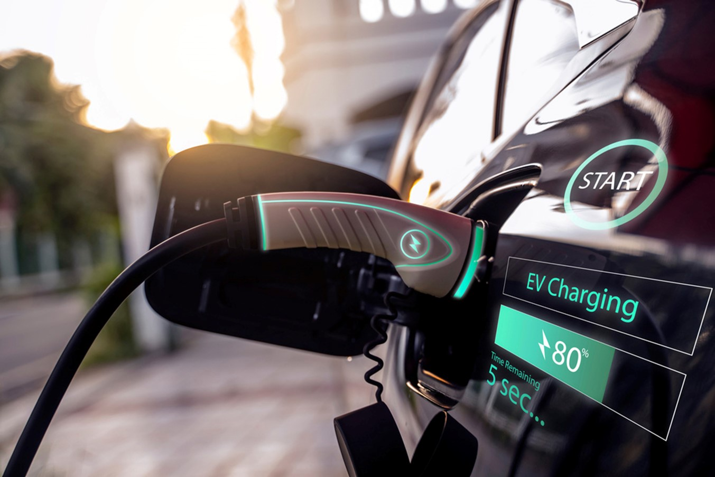
CONTENTS
Introduction
Literature Survey
Problem Definition &Objectives of Project Work
Objectives
Existing System & Proposed System
Methodology
Advantages & Disadvantages
Requirement Specifications
Design & Implementation
Conclusion
Results
Future Scope

Slide 3
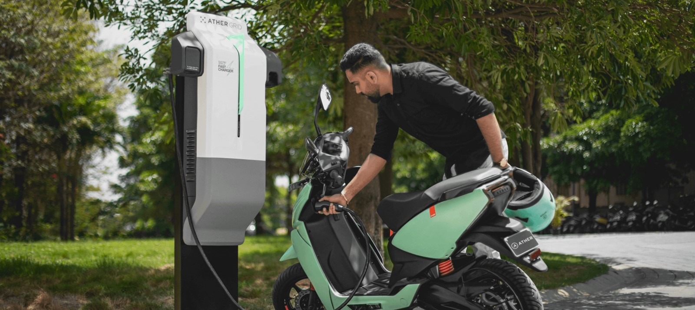
INTRODUCTION
• The project focuses on electric
vehicles (EVs) and smart EV charging systems. An electric vehicle uses electric motors for propulsion and can be powered by an external collector system or autonomously by a battery.
• Smart EV charging involves a data connection between the EV, charging device, and charging operator. Additionally, the project addresses the growing demand for Compressed Natural Gas (CNG) as an alternative fuel due to its environmental and cost benefits. However, the project aims to tackle the challenge of long waiting times at CNG pumps, aiming to reduce inconvenience and time wastage for CNG users.

Slide 4

PROBLEM STATEMENT
• As the rising use of electric vehicles, we need better charging systems. Current infrastructure problems make it hard to smoothly include electric vehicles in everyday transportation.
• There's no organized appointment system, leading to unpredictable wait times and a less-than-ideal user experience. We need a
solution that lets users pre-book CNG refueling
appointments to reduce waits and make the process
more efficient.

Slide 5

LITERATURE SURVEY
• Smart Electric Vehicle Charging System: Case study on infrastructure of EV charging station. João C. Ferreira, Vítor Monteiro, João L. Afonso, Alberto Silva Member, IEEE(2021)
• An in-depth analysis of electric vehicle charging station infrastructure: Case study
on EV charging station. Muhammad Shahid Mastoi a , Shenxian Zhuang a , Hafiz Mudassir Munir b , Malik Haris c (2022)
•Online Booking System for CNG Pump: By Vaishnavi Shinde, Saloni Pawar, Purva Patel,
Sakshi Ghorpade, Nilesh Wankhede, International Journal for Scientific Research &
Development| Vol. 11, Issue 3. (2023)

Slide 6
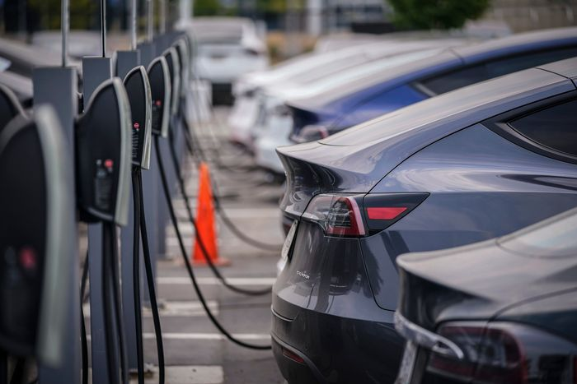
OBJECTIVES
To enable faster adoption of electric vehicles by ensuring safe, reliable, accessible and affordable charging infrastructure and eco-system.
To promote affordable tariff chargeable from EV owners and charging station operators.
To encourage preparedness of electrical distribution system to adopt EV charging infrastructure.
The user can locate nearby CNG pump and can book a appointment by maintaining virtual queue for each pump which is simple and easy to use .
To enable users to book appointments for CNG refueling at their preferred pump stations, to provide a user-friendly interface for easy registration and login.

Slide 7
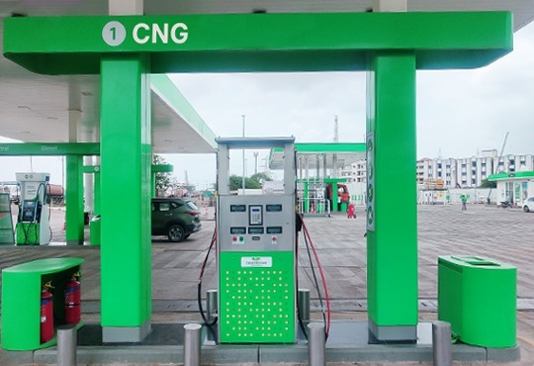
EXISTING SYSTEM
• Inherent risks, such as battery cost and degradation, economic risks, lack of charging
infrastructure, risky maintenance of EVs, problems of integration in smart grids, range anxiety,
auxiliary loads, and motorist attitude, are not adequately addressed.
• The choice of location plays a vital role in ensuring electric vehicle adoption. The cumulative
effect of these issues underscores the need for an improved system to address the challenges associated with electric vehicle charging.
Drivers face difficulties in locating electric vehicle charging stations.
• The existing system lacks a smart charging infrastructure network.
• The process of selecting locations for installing charging stations
is crucial.

Slide 8
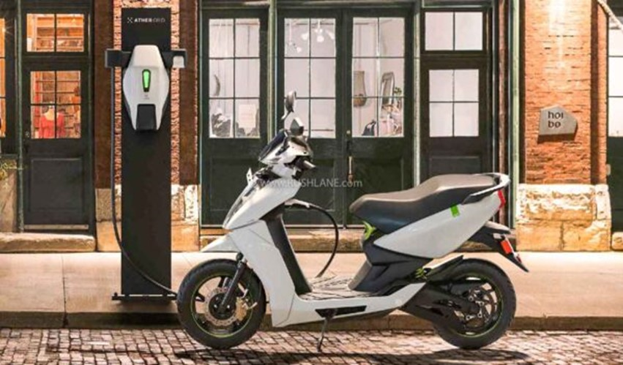
PROPOSED SYSTEM
The system utilizes a codebase comprising Python, Embedded Javascript (EJS). Embedded JS contribute to the user interface (front-end), while Python facilitates the connection between Hardware Components
Node.js is used as runtime environment that allows to run Javascript code outside web browser and MongoDB is used to store data and is a popular Database system which is flexible and scalable.
The project addresses the problem by introducing an
affordable electric vehicle charging model.

Slide 9
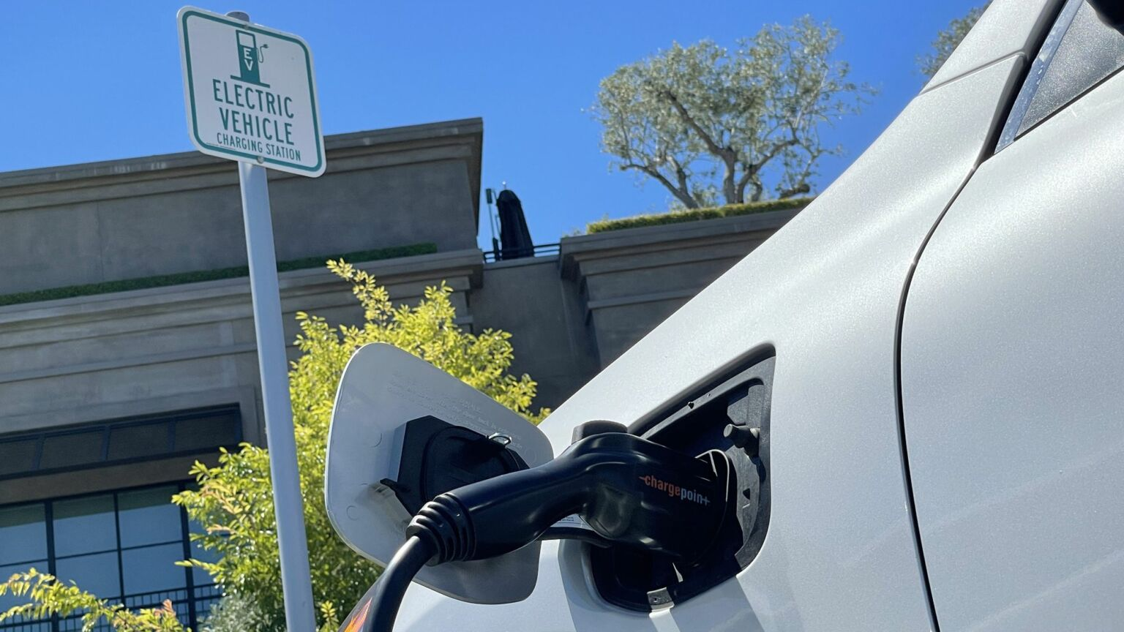
The main aim of the proposed system is to avoid customer spending time in queue.
Each pump will have queue of customized slots each of 5 to 10 minutes which user can view whichever user want can book it but before booking user must do login.
In the we have a page Pump Queue were user can view the queue of each pump and accordingly make a appointment with pumps having lesser queue.
The integrated approach ensures an efficient and cost-effective electric vehicle charging solution.

Slide 10

METHODOLOGY
• User Registration & Login: Users sign up to access the service
and log in for personalized access to station booking and payment.
• Locate Nearby Charging Stations: Utilize location services to find the closest charging stations with available slots for booking.
• Display Plans: Present users with various charging plans based on their needs and preferences.
• Select & Pay for Plan: Users choose a plan and securely make payment transactions within the platform.

Slide 11
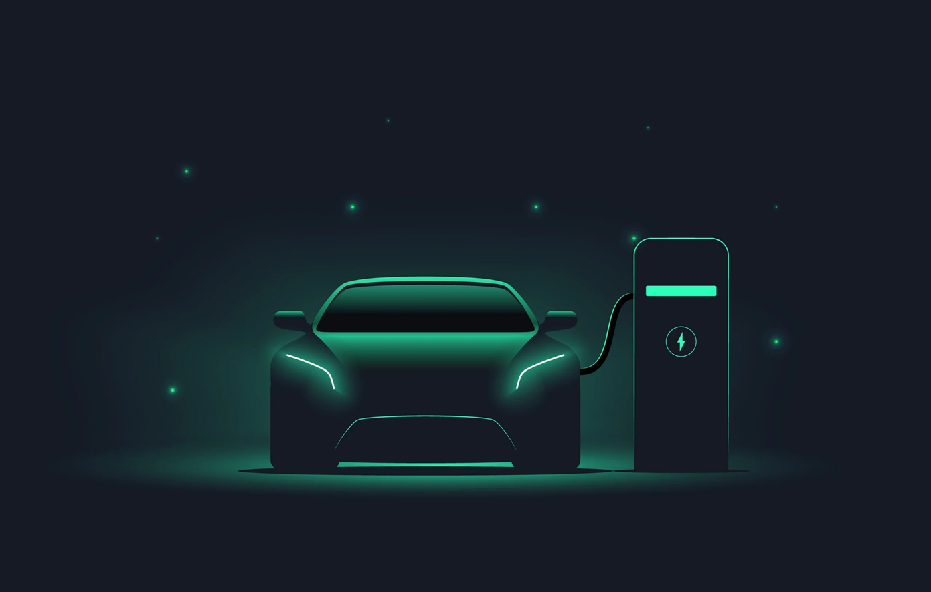
• Track Location & Charging Progress: Real-time tracking of
user's location and charging progress for efficient monitoring.
• Hardware Integration for Charging: Connect the user's electric vehicle to the charging station using the platform's hardware prototype.
• Monitor Charging Status: Continuously check the status of the charging process to ensure smooth operation and completion.
• Testing & Deployment: Thoroughly test the system for functionality and deploy it for users to use reliably.

Slide 12
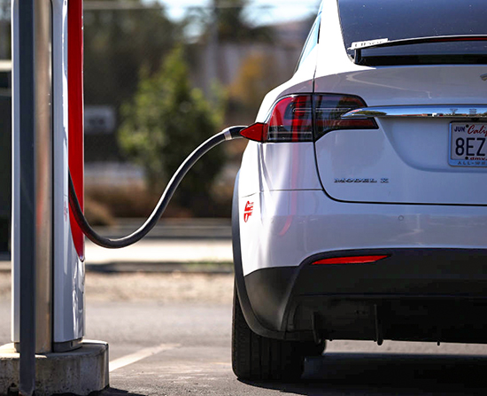
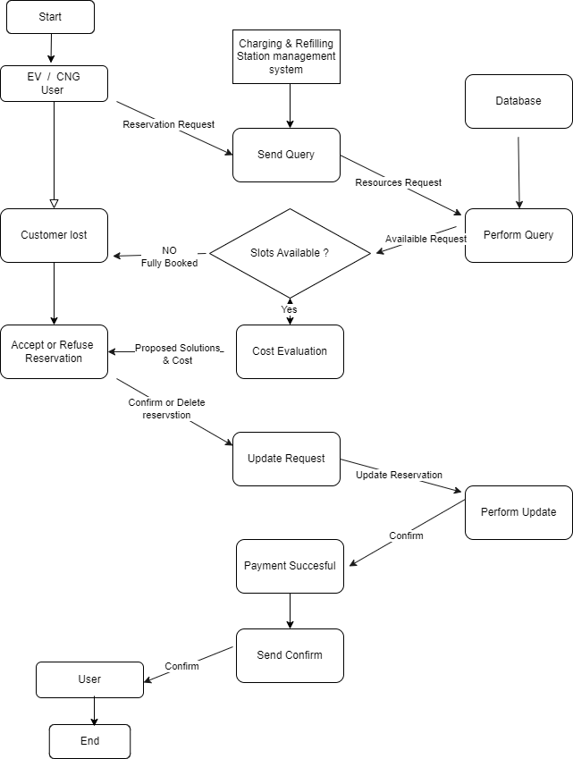
WORK FLOW DIAGRAM

Slide 13
ADVANTAGES & DISADVANTAGES
Efficient Energy Use
Encourages EV Adoption
Charging Timing
Cost Effectiveness
Quick Refueling
Smart Resource Allocation
Initial Cost
Technological Complexity
Limited Charging Infrastructure
Limited Vehicle Availability
Storage & Safety Concern
Infrastructure Challenges

Slide 14

REQUIREMENT SPECIFICATION
Hardware Requirements
Software Requirements
Node MCU
LCD Display
Relay
IOT Cloud(ThingSpeak)
Python
Embedded Javascript
Node.js
MongoDB

Slide 15

IMPLEMENTATION
Web Application Implementation
Hardware Component Integration
Integrated Development Environment (IDE)
Features Implementation

Slide 16

STEPS OF IMPLEMENTATION
•After the problem identification, we came up with an idea of an affordable electric vehicle charging model.
•We analyzed the components to be used and the ones which were cost efficient and which were easily available were taken into consideration for the making of the prototype.
•Firstly, the block diagram and the circuit diagram were made to align the components according to our requirement and the circuit was verified.
•After the verification of the circuit, we assembled the components and the prototype was made.
•Then we worked on the code which consists the languages- Python and Javascript.

Slide 17
•Emedded JS is used for creating the user interface.
•Python is used for connecting the Node MCU and the ThinkSpeak cloud.
•The code was dumped to the Node MCU.
•3.3V of power was supplied to the Node MCU, 5V of power was supplied to relay and LCD display using power supply module.
•To make the prototype work, the code was compiled successfully and run.

Slide 18
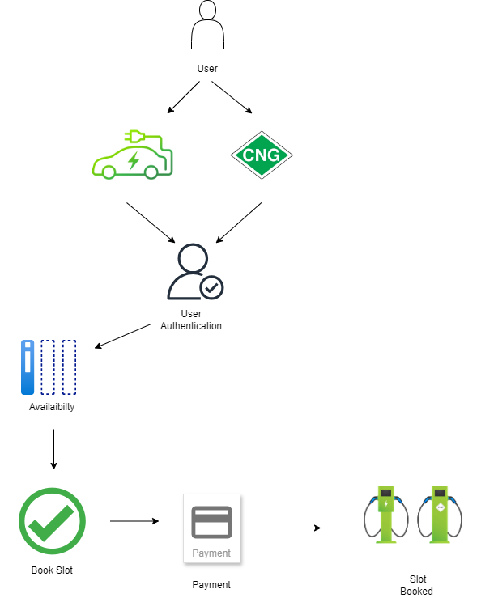
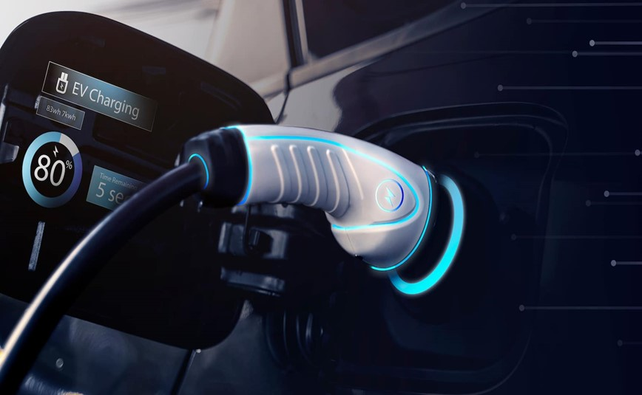
DESIGN & IMPLEMENTATION
SYSTEM ARCHITECTURE:
The architecture of the system consists of a Web Application provides a user-friendly interface accessible via web browser and the User Account Management Handles user registration, authentication, and profile management.

Slide 19
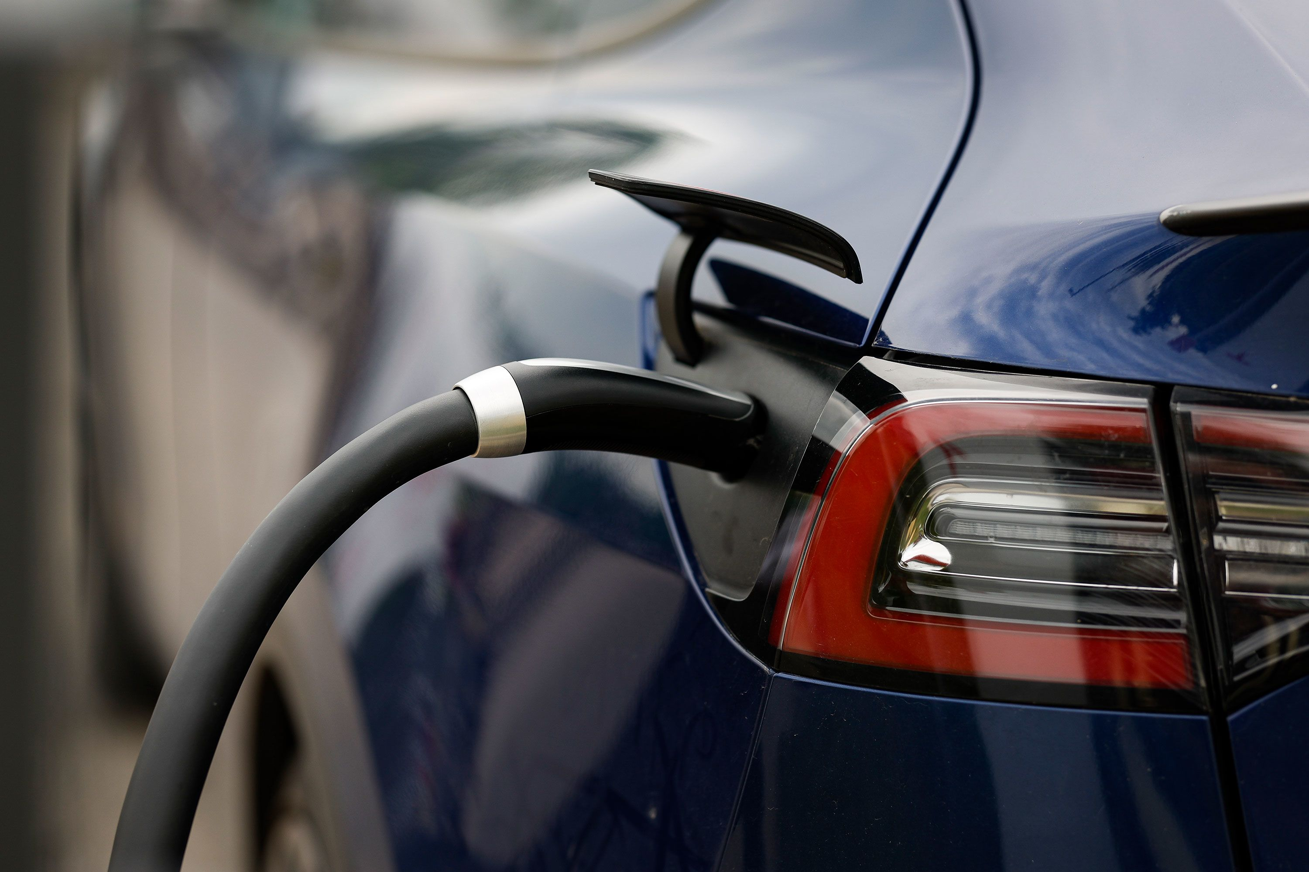
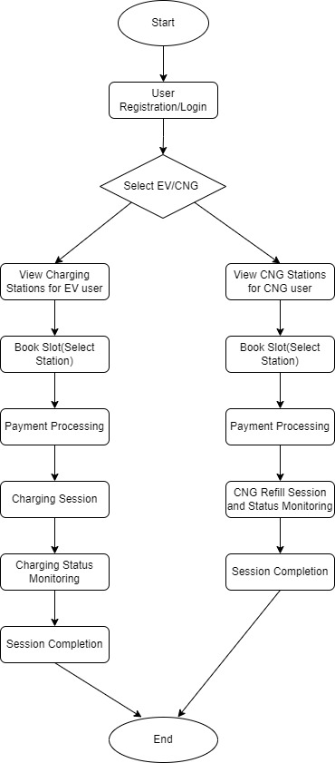
DATAFLOW DIAGRAM
The Data Flow Diagram showcases how data moves through our website application for our Project. It outlines the various processes, data sources, destinations, and data flows within the system.

Slide 20
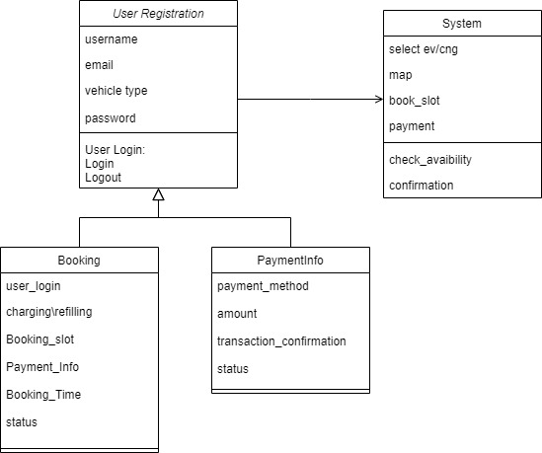
CLASS DIAGRAM

Slide 21
TESTING
UNIT TESTING
INTEGRATION TESTINGESTING
User Registration and Login
Selecting EV Recharge Station option
Selecting CNG Refill Station option
Node MCU connection
Relay Functionality
LED Display Output

Slide 22

CONCLUSION
In conclusion, the development of the "Smart Charging
and CNG Booking System for Sustainable Transportation" represents a significant step forward in the realm of eco-friendly mobility solutions. Through the integration of user-friendly web applications and a demonstrative hardware prototype, the project offers a comprehensive platform aimed at facilitating the transition towards sustainable transportation practices.

Slide 23

RESULTS

Slide 24


Slide 25
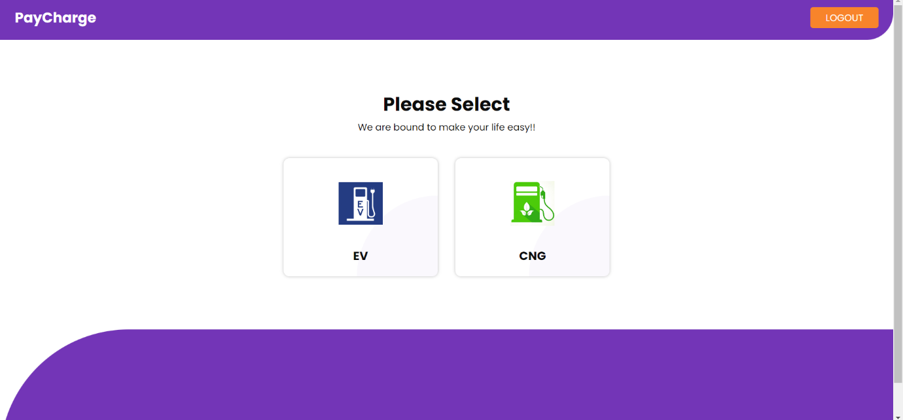

Slide 26
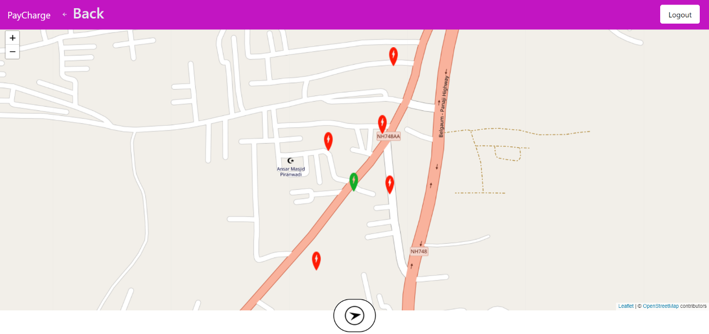

Slide 27
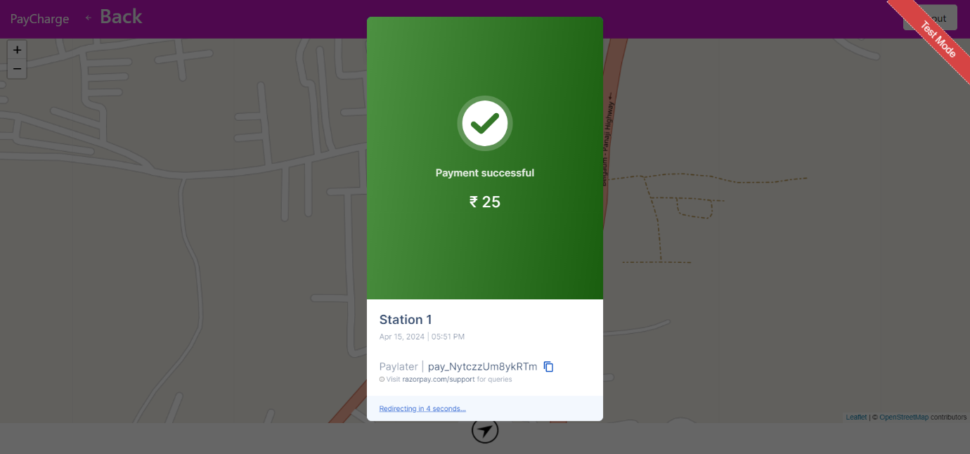

Slide 28
FUTURE SCOPE
Electric vehicles are the future not only of transport but of our planet. These vehicles are plugged into a charging station at a minimal voltage; therefore, no emissions are released which are harmful to our environment.

